Slide 1

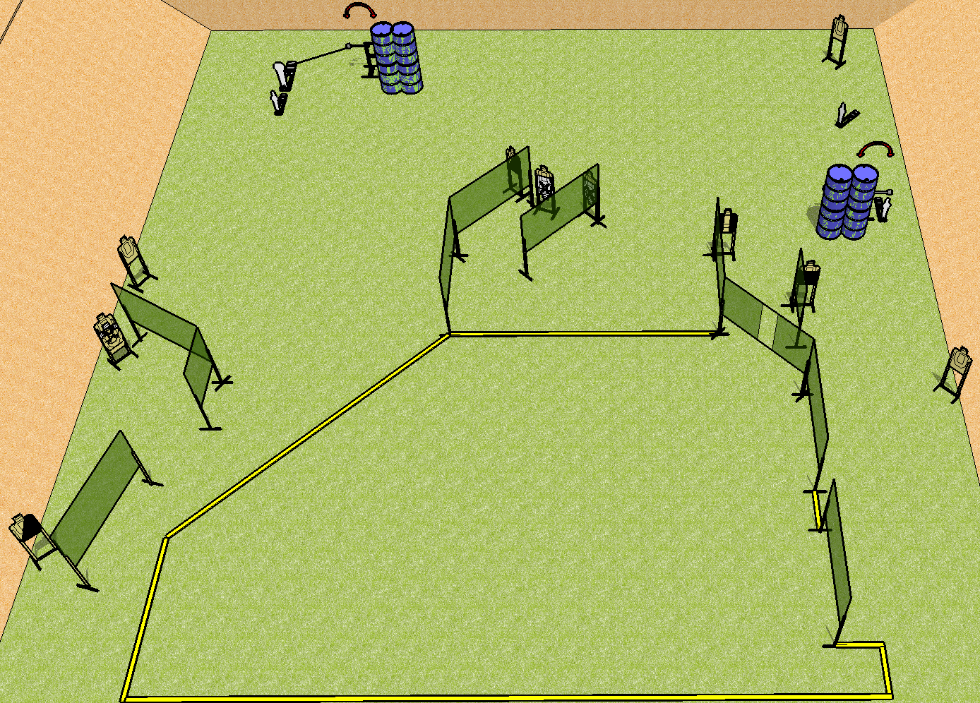
 | Dothan Practical Shooters – USPSA Match Double Trouble Course Designer : Drew Coleman Bay: A2
Round Count 30 rounds 13 USPSA 1 colt popper, 3 mini poppers
Equipment List 20 wall feet 2 swingers + activator 1 tux, 2 right diag, 1 50% 12 targets (9 + 3NS)

Slide 2
Double Trouble
Written Stage Briefing
Scoring: Comstock Rounds: 30
Targets: 13 USPSA, 4 steel
Handgun start position: anywhere inside the shooting area, wrists below belt. Handgun is loaded and holstered.
PCC start position: anywhere inside the shooting area, stock on belt. Loaded carbine is held with both hands, stock on belt.
Stage Procedure: on the audible start signal, engage targets as they become available from within the shooting area. S1 is activated by P2 and remains visible at rest, S2 is activated by P4 and remains visible at rest.

